Slide 1
CS 135 Scalable SW Architecture
Chapter 1 and 2 of Distributed Systems: Concepts and Design

Slide 2
Lets review …
A Distributed System (DS) is a collection of independent computers, interconnected via a network, which are able to coordinate on a task and appear to users as a single coherent system.
Some of the characterisitic of as DS are:
Concurrency – execution in parallel is the norm
No global clock – no synchronized clock
Message passing – computers need to communicate via message passing
Independent failiers – failure of one node in the DS, should not affect the system
The World Wide Web (WWW) is a distributed system of web servers and web browsers (and we will use the WWW as a example of a DS going forward).

Slide 3
Challenges of DS
Heterogeneity – variety of programming lang., OS, networks, hardware, etc.
One nice thing about the internet, it uses a standard internet protocol to connect all the computers.
Middleware – a software layer that masks the heterogeneity of the underlying network (Ex. CORBA, RMI)
Security – must consider confidentiality, integrity and availability of the data that is being shared across the DS.
Scalability – DS must scale with increasing number of resources (nodes connected to the network) and users.
Notes:
Common Object Request Broker Architecture (CORBA)
Remote Method Invocation (RMI)

Slide 4
Challenges of DS (cont.)
Failure Handling – failure of nodes in a DS is the norm and should be handled
Detect – detect failure, for example, checksums can be used to detect incomplete or corrupt data in a message.
Mask – hide failure from the user when possible, by retransmitting messages, or having redundant disks/servers that host the data.
Recovery – recover from failures by maintain logs utilized in “played back recover” or utilizing redundant components.
Concurrency – handling concurrent access request to resources on the DS without sacrificing availability and high throughput.
Transparency – concealment of the underlying DS from the user or the application programmer (ex. location transparency, failure transparency, etc.)

Slide 5
Software Architecture of a DS
Usually employs a layered architecture
Lower two layers comprise the platform
Middleware is a software layer used to mask the heterogeneity of the system and provide a consistent programming model for application developers.
Usually provides abstraction using :
Remote method invocation
Event notification
Real-time data transmission
Object replication
Group communication
Ex. RappidMQ, Kafka, etc.
Application layer provides application-specific functionality
Applications
Middleware
Operating System
platform
Network Hardware

Slide 6
Software Architectures
The application layer defines the functional role of each component in a distributed system (components may have the same or different roles).
The choice of architecture can impact the design considerations:
Responsiveness - how quickly does the system respond to requests?
Throughput - how many requests can the system handle (per second, for example)?
Load Distribution - are requests distributed evenly among components of the system?
Fault Tolerance – can the system continue to handle requests in the face of a failed component?
Security – does the system ensure that sensitive resources are guarded against attack?
Lets take a look at some common architectures
Client-Server
P2P

Slide 7
Distributed System Architecture
Client – Server Architecture
Client: Process wishing to access data, use resources, etc.
Server: Process managing data and all other shared resources among servers, clients, allowing client access to resources and computation
The client and server communicate using some protocol
Examples:
File Servers (like Google Drive)
DNS Servers
Web Servers
Search Engines
Database Servers
Scalability is limited by the capacity of the server and bandwidth of network connections.

Slide 8
DNS Example
Domain Name System (DNS) is used to map hostnames to IP addresses.
Your browser performs the following operations:
The hostname is extracted from the URL.
The browser sends a query to the DNS server. (How does it know where to find the DNS server?)
The server replies with the IP address.
The browser opens a TCP connection and sends the HTTP request.
But what is the underlying architecture?

Slide 9
DNS Example (Cont.)
DNS is implemented as a distributed, hierarchical database. There are three classes of DNS servers:
Root servers - There are 13 root name servers worldwide. These servers maintain the IP address of all of the top-level domain servers.
Top-level domain servers - TLD servers are each responsible for a particular domain (e.g., com, edu).
Authoritative servers - Each organization (e.g., CMC or Amazon) maintains the DNS server that can provide authoritative mappings from hostname to IP.
How does DNS address the complexities of distributed computing?
Heterogeneity - standard protocals are used
Openness – Standards in place
Security - There are some vulnerabilities but also ways to ensure a reasonable level of security.
Scalability - The hierarchical nature of DNS makes it very scalable.
Failure Handling - The failure of one DNS server does not impact the ability of others to continue to do resolution.
Concurrency - Many requests can happen simultaneously and data is distributed over a large number of hosts.
Transparency - the user (and end host) need not know about root or TLD servers.

Slide 10
Distributed System Architecture (Cont.)
Peer-to-Peer Architecture
The peer-to-peer model assumes that each node in the network has equivalent functionality, and must interact cooperatively as peers.
Examples:
Skype underlying architecture
Wireless sensor networks
File Servers (BitTorrent)
Napster
NoSQL DB (Amazon Dynamo)
BitCoin

Slide 11
Skype’s P2P Architecture
Skype uses ‘hierarchical’ or superpeer systems
Skype leverages their users to create a decentralized P2P system… essentially it may be using your computer to store and forward data across the network.
Skype identified certain nodes as ‘supernodes’ that would serve for indexing and as networking address translation (NAT) nodes.
These nodes are selected from among the different users, of course without them knowing, by an algorithm which did the selecting based on their uptime, their not being restricted by their operating systems or firewalls, and on the update of the P2P protocol.

Slide 12
P2P Advantages / Disadvantages
The P2P network is created using the existing network and resources … hence it has the advantage of allowing the service to grow with the number of users.
Ideally, P2P reduces bottlenecks and enables each node to contrinute resources to the system.
May not always be true in practice: Free Riding on Gnutella, Skype
Furthermore:
it is difficult to build in a robust way, and suffers from security threats.
its diffuclut to find peers on the network and locate information on these peers.
However, when we talk about databases we will discuss Amazon Dynamo (a NoSQL database) that sucsessful implemented P2P architecutre as a file system.

Slide 13
Distributed System Architecture (Cont.)
Proxies & Caches
A proxy server is used to cache content and deliver it to any client within the network.
Client request an object from server and the proxy server intercepts the request
If the object is cached at the proxy server, it will serve the object itself, otherwise it will forward the request to the original destination server.
Internet
Client
Proxy Server
Original Server

Slide 14
Distributed System Architecture (Cont.)
Network Computers/Thin Clients
The network computer model assumes that the end user machine is a low-end computer that maintains a minimal OS.
When it boots, it retrieves the OS and files/applications from a central server and runs applications locally.
The thin client model is similar, though assumes that the process runs remotely and the client machine simply displays results (e.g., X-windows and VNC).
This is becoming more popular with the ubiquitous adoption of cloud computing.

Slide 15
Distributed System Architecture (Cont.)
Mobile Devices
Typically when we discuss client-server and p2p systems, we are assuming the network is composed of high-end servers or laptops/desktops.
However, there is increased interest in systems that run on top of distributed devices such as cellphones, cameras, etc.
Instead of communicating over the Internet (or local area networks), these devices communicate via wireless technologies (Bluetooth, etc.)
These systems have different considerations: battery life, architecture of network (how many nodes are connected), etc.

Slide 16
Design DS considerations
Interaction
Nodes in a DS communicate and coordinate by passing messages
Latency – time between the sending and receiving the message
Bandwidth – total amount of information that can be transmitted
Jitter - variation in time taken to deliver a message
Failure
Designing a distributed software application is not easy, many things can go wrong
Important failures that may occur in a system :
Failstop – a process halts and remains halted (other processes can detect that process has failed)
Message omission – a message put in incoming buffer, but never received
Security
Potential threats a system designer should be aware of:
Threats to processes – an attacker may send a request or response using a false identity
Threats to communication channels – an attacker may eavesdrop (listen to messages) or inject new messages into communication channel
Denial of service – an attacker may overload a server by making excessive requests.

Slide 17
Distributed Systems
We will discuss DS in more detail next time, specifically focusing on DS models (like client-sever, peer-2-peer, publish-subscribe system, etc.)
For now, lets examine the structure of the WWW and then flow of message between a client and a server.

Slide 18
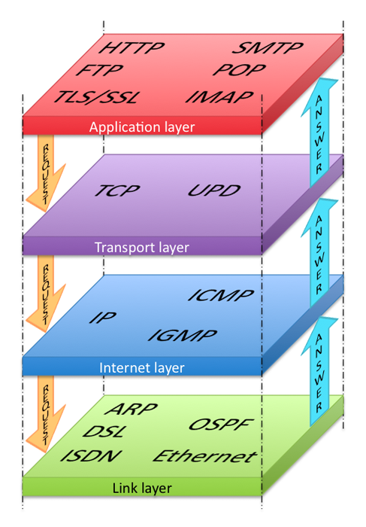
Layered Architecture
Higher protocols that allow applications to interact with the transport layer
Ensures transmissions arrive in order and without error
Establishes connection, routing, and addressing
Responsible for physical transmission of raw bits

Slide 19
Link Layer
The link layer is the lowest layer, responsible for both the physical transmission across media (wires, wireless) and establishing logical links.
It handles issues like packet creation, transmission, reception and error detection, collisions, line sharing and more.

Slide 20
Internet Layer
The internet layer (sometimes also called the IP Layer) routes packets between communication partners across networks.
Every device connected to the Internet has an IP address, which is a numeric code that is meant to uniquely identify it.
Your IP address will generally be assigned to you by your Internet Service Provider (ISP).
In organizations, large and small, purchasing extra IP addresses from the ISP is not cost effective.
In a local network, computers can share a single IP address between them.
The router, which has a static address, can delegate dynamic IP address to the devices connected to it.

Slide 21
IP Addresses
IPv4 addresses are the IP addresses from the original TCP/IP protocol.
In IPv4, 12 numbers are used (implemented as four 8-bit integers), written with a dot between each integer.
Since an unsigned 8-bit integer's maximum value is 255, four integers together can encode approximately 4.2 billion unique IP addresses.
IPv6 is newer version of IP addresses.
It uses eight 16-bit integers for 2¹²⁸ unique addresses, over a billion billion times the number in IPv4.
These 16-bit integers are normally written in hexadecimal, due to their longer length.

Slide 23
Transport Layer
The transport layer ensures transmissions arrive, in order, and without error.
This is accomplished through a few mechanisms.
First, the data is broken into packets formatting according to the Transmission Control Protocol (TCP).
Secondly, each packet is acknowledged back to the sender so in the event of a lost packet, the transmitter will realize a packet has been lost since no ACK arrived for that packet.
That packet is retransmitted, and although out of order, is reordered at the destination.

Slide 24
TCP vs UDP
TCP (Transmission Control Protocol) – Protocol built upon the IP networking protocol, which supports sequenced, reliable, two-way transmission over a connection (or session, stream) between two sockets
UDP (User Datagram Protocol) – Also protocol built on top of IP. Supports best-effort, transmission of single datagrams
Use:
TCP when you need reliability, but when performance of setting up connection is not a huge (e.g., file transmission, a lock service)
UDP when it’s OK to lose, re-order, or duplicate messages, but you want low latency (e.g., online games, messaging, games)
Notes:
A protocol is a set of rules that are used when computers communicate.
The TCP/IP Internet protocols were originally abstracted as a four-layer stack.
Later abstractions subdivide it further into five or seven layers.
Since we are focused on the top layer anyhow, we will use the earliest and simplest four-layer network model.

Slide 25
Application Layer
With the application layer, we are the level of protocols familiar to most web developers.
Application layer protocols implement process-to-process communication and are at a higher level of abstraction in comparison to the low-level packet and IP addresses protocols in the layers below it.
Examples: HTPP, SSH, FTP, DNS, POP, SMTP.

Slide 26
What happens when you navigate to a URL?
We will concentrate on the application layer and the communication that is made between the client and server when a URL is requested.
Lets take a look at the sequence of events that take place when you visit a URL (like facebook.com)

Slide 27
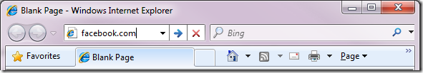
1 – You enter a URL into a browser
It all starts with you typing a URL in the browser
Notice, I typed http://facebook.com instead of http://www.facebook.com

Slide 28

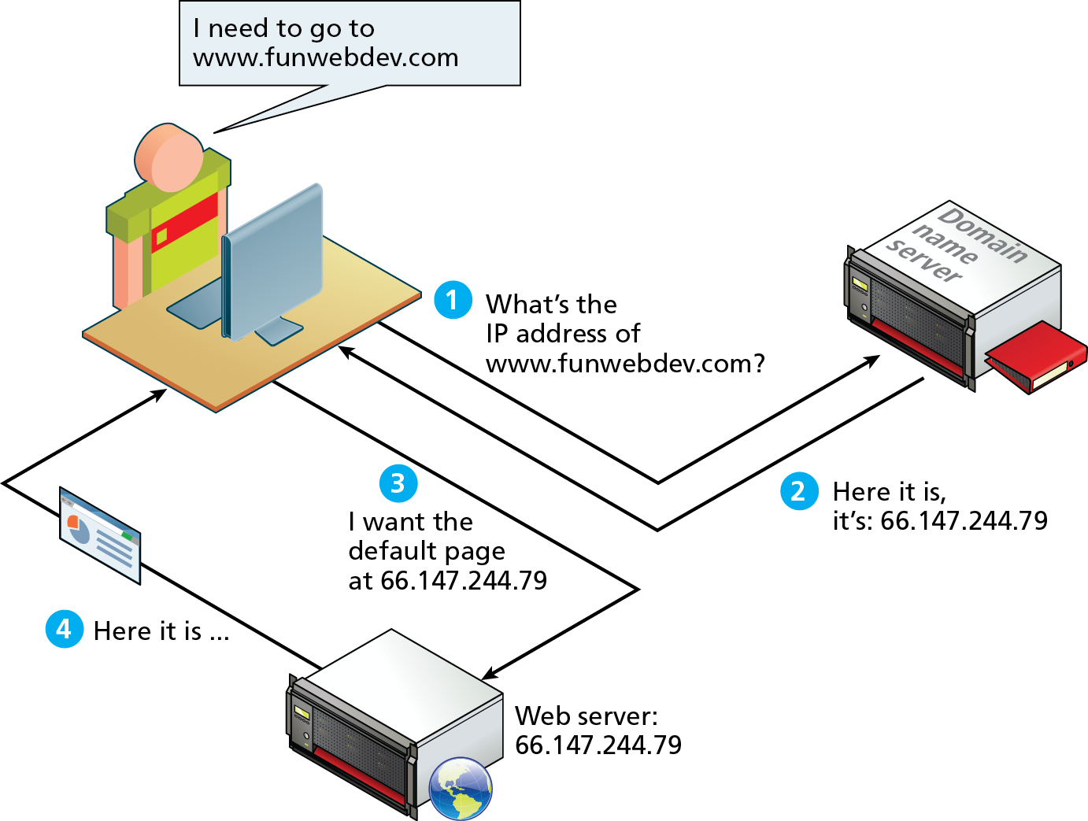
2 – Browser looks up IP via DNS server
As elegant as IP addresses may be, we do not enjoy having to recall long strings of numbers.
Instead of IP addresses, we use the Domain Name System (DNS) to lookup the the IP address associated with a given domain.
Also, by separating IP from domain name, a site can move to a different location without changing its name.

Slide 29
Domain Levels
TLD
Unrestricted: .com, .net, .org, .info
Sponsored: .gov, .mil, .edu
Country Codes: .us,.ca, .uk, .au

Slide 30
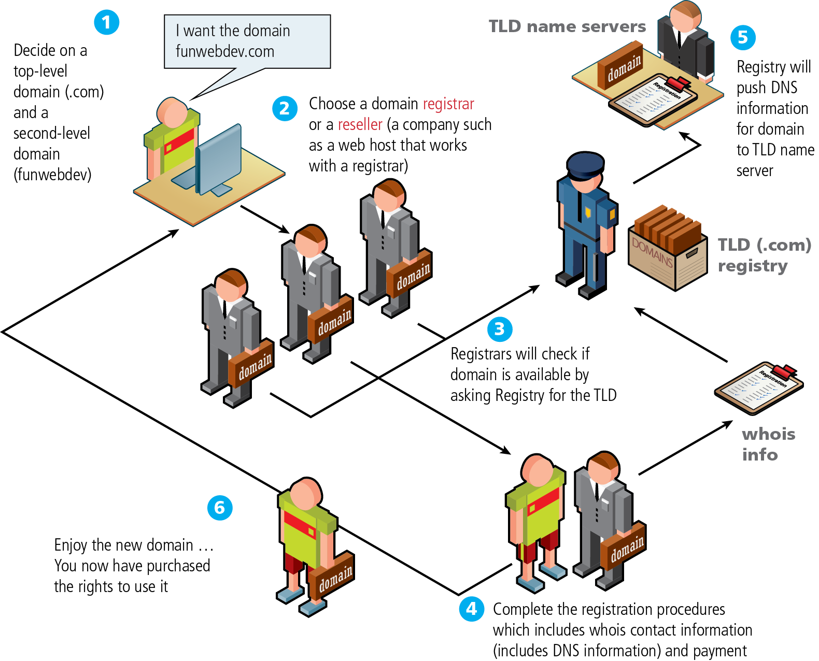
Name Registration
How are domain names assigned?
Special organizations or companies called domain name registrars manage the registration of domain names.
These domain name registrars are given permission to do so by the appropriate generic top-level domain (gTLD) registry and/or a country code top-level domain (ccTLD) registry.

Slide 31
DNS Address Resolution
So, IP lookup (referred to as address resolution) is not as simple as was shown in the previous slide.
The DNS is a distributed database system (no longer centralized) of name servers.
From your perspective, its like a phonebook, mapping a unique name to a number.
The address resolution process goes through the following steps:

Slide 32
IP Address Resolution
The DNS lookup proceeds as follows:
Browser cache – The browser caches DNS records for some time.
OS cache – If the browser cache does not contain the desired record, the browser makes a system call to get the data from the OS … if avaiable.
Router cache – The request continues on to your router, which typically has its own DNS cache.
ISP DNS cache – The next place checked is the cache ISP’s DNS server.
Recursive search – Your ISP’s DNS server begins a recursive search, from the root nameserver, through the .com top-level nameserver, to Facebook’s nameserver. Normally, the DNS server will have names of the .com nameservers in cache, and so a hit to the root nameserver will not be necessary
Notes:
One worrying thing about DNS is that the entire domain like wikipedia.org or facebook.com seems to map to a single IP address. Fortunately, there are ways of mitigating the bottleneck:
Round-robin DNS is a solution where the DNS lookup returns multiple IP addresses, rather than just one. For example, facebook.com actually maps to four IP addresses.
Load-balancer is the piece of hardware that listens on a particular IP address and forwards the requests to other servers. Major sites will typically use expensive high-performance load balancers.
Geographic DNS improves scalability by mapping a domain name to different IP addresses, depending on the client’s geographic location. This is great for hosting static content so that different servers don’t have to update shared state.
Anycast is a routing technique where a single IP address maps to multiple physical servers. Unfortunately, anycast does not fit well with TCP and is rarely used in that scenario.
Most of the DNS servers themselves use anycast to achieve high availability and low latency of the DNS lookups.

Slide 33
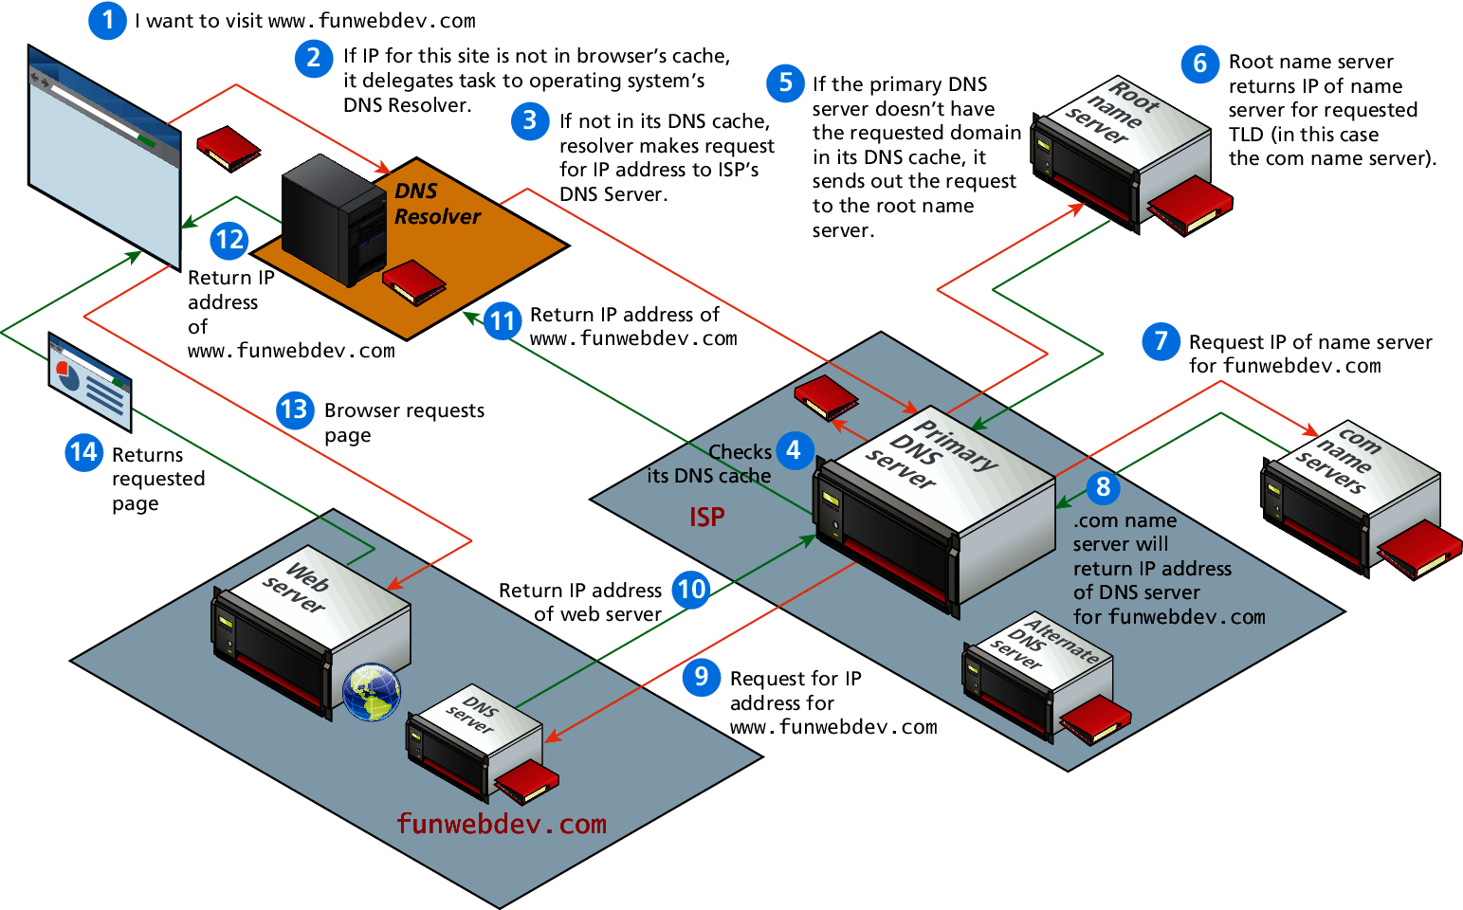
Domain name address resolution process

Slide 34
URL Components
In order to allow clients to request particular resources from the server, a naming mechanism is required so that the client knows how to ask the server for the file.
For the web that naming mechanism is the Uniform Resource Locator (URL).

Slide 35
Query String
Query strings will be covered in depth when we learn more about HTML forms and server-side programming.
They are the way of passing information such as user form input from the client to the server.
In URL's they are encoded as key-value pairs delimited by “&” symbols and preceded by the “?” symbol.
EX: https://www.yelp.com/search?find_desc=Restaurants&find_loc=Boston

Slide 36

3. The browser sends a HTTP request to the web server
So now the browser knows the IP address of the server, the next step is to issue a HTTP GET request.
You can be pretty sure that Facebook’s homepage will not be served from the browser cache because dynamic pages expire either very quickly or immediately (expiry date set to past).
So, the browser will send this request to the Facebook server:
HTTP establishes a TCP connection on port 80 (by deafult)
GET http://facebook.com/ HTTP/1.1
Accept: application/x-ms-application, image/jpeg, application/xaml+xml, [...]
User-Agent: Mozilla/4.0 (compatible; MSIE 8.0; Windows NT 6.1; WOW64; [...]
Accept-Encoding: gzip, deflate
Connection: Keep-Alive
Host: facebook.com
Cookie: datr=1265876274-[...]; locale=en_US; lsd=WW[...]; c_user=2101[...]
Notes:
The GET request names the URL to fetch: “http://facebook.com/”. The browser identifies itself (User-Agent header), and states what types of responses it will accept (Accept and Accept-Encoding headers). The Connection header asks the server to keep the TCP connection open for further requests.
The request also contains the cookies that the browser has for this domain. As you probably already know, cookies are key-value pairs that track the state of a web site in between different page requests. And so the cookies store the name of the logged-in user, a secret number that was assigned to the user by the server, some of user’s settings, etc. The cookies will be stored in a text file on the client, and sent to the server with every request.

Slide 37
HTTP Request Headers
Headers are sent in the request from the client and received by the server.
These headers include data about the client machine that can be used by a developer for analytical reasons or personalization.
Host: requests for different domains can arrive at the same IP, the host tells the server which
User-Agent: specifying OS and browser used by the client
Accept: tells the server what kind of media types the client can receive
Accept-Encoding: specify what types of modifications can be done to the data before transmission
Connection: specifies whether the server should keep the connection open, or close it after the response.
Cache-Control: allows the client to control caching mechanisms.

Slide 38
Request Methods
HTTP protocol defines several different types of requests, each with a different intent.
GET, POST, HEAD ( and a few seldom used requests such as PUT, DELETE, CONNECT, TRACE, OPTIONS)
GET request – request for a resource located at a specified URL
POST request – Used to transmit data to the server using an HTML form
HEAD request – similar to GET, but only includes the header of a page (not the content) … used by search engines to see if a page needs to be reindexed.

Slide 39
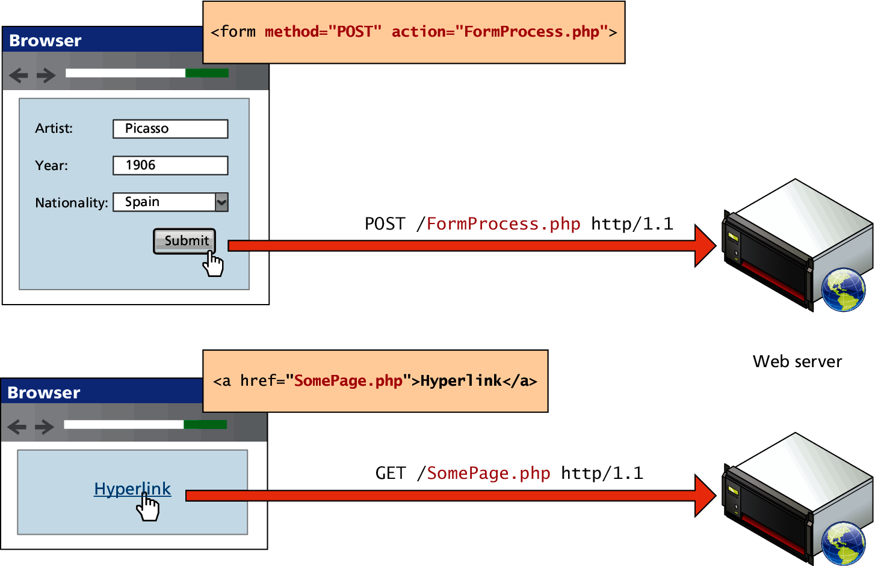
GET versus POST requests

Slide 40
4. The server responds with a permanent redirect
So, once the client sends a GET request, the server will respond.
This is the response that the Facebook server sent back to the browser request:
The server responded with a 301 Moved Permanently response to tell the browser to go to “http://www.facebook.com/” instead of “http://facebook.com/”.
HTTP/1.1 301 Moved Permanently
Cache-Control: private, no-store, no-cache, must-revalidate, post-check=0,
pre-check=0
Expires: Sat, 01 Jan 2000 00:00:00 GMT
Location: http://www.facebook.com/
P3P: CP="DSP LAW"
Pragma: no-cache
Set-Cookie: made_write_conn=deleted; expires=Thu, 12-Feb-2009 05:09:50 GMT;
path=/; domain=.facebook.com; httponly
Content-Type: text/html; charset=utf-8
X-Cnection: close
Date: Fri, Wed, 18 Jan 2017 21:16:53 GMT
Content-Length: 0

Slide 41
Response Codes
Code | Description
200: OK | The request was successful
301: Moved Permanently | Tells the client the request URL permanently moved, and the new location for that resource is returned in the response.
304: Not Modified | Notifies the client that the requested URL is no newer than the one in the client cache.
307: Temporary redirect | Similar to 301, it redirects the browser to another URL (considered temporary).
400: Bad Request | Something about the HTTP request is not correct.
401: Unauthorized | Client doesn’t have the credentials to access the resource
404: Not found | Requested resource is not found
414: Request URI too long | URLS have a length limitation, hence a 414 is issued when too much data is being transmitted.
500: Internal server error | The server has encountered an internal error and cannot respond to the request

Slide 42
5. The browser follows the redirect
The browser now knows that http://www.facebook.com/ is the correct URL to go to, and so it sends out another GET request:
The meaning of the headers is the same as for the first request.
GET http://www.facebook.com/ HTTP/1.1
Accept: application/x-ms-application, image/jpeg, application/xaml+xml, [...]
Accept-Language: en-US
User-Agent: Mozilla/4.0 (compatible; MSIE 8.0; Windows NT 6.1; WOW64; [...]
Accept-Encoding: gzip, deflate
Connection: Keep-Alive
Cookie: lsd=XW[...]; c_user=21[...]; x-referer=[...]
Host: www.facebook.com

Slide 43
6. The server ‘handles’ the request
The server will receive the GET request, process it, and send back a response.
This may seem like a straightforward task, but in fact there is a lot of interesting stuff that happens here – even on a simple site, let alone on a massively scalable site like Facebook.

Slide 44

7. The server sends back a HTML response
Here is the response that the server generated and sent back:
HTTP/1.1 200 OK
Cache-Control: private, no-store, no-cache, must-revalidate, post-check=0,
pre-check=0
Expires: Sat, 01 Jan 2000 00:00:00 GMT
P3P: CP="DSP LAW"
Pragma: no-cache
Content-Encoding: gzip
Content-Type: text/html; charset=utf-8
X-Cnection: close
Transfer-Encoding: chunked
Date: Fri, 12 Feb 2010 09:05:55 GMT
2b3
��������T�n�@����[...]

Slide 45
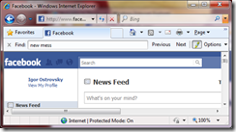
8. The browser begins rendering the HTML
Even before the browser has received the entire HTML document, it begins rendering the website:

Slide 46

9. The browser sends requests for objects embedded in HTML
As the browser renders the HTML, it will notice tags that require fetching of other URLs. The browser will send a GET request to retrieve each of these files.
Here are a few URLs that my visit to facebook.com retrieved:
Images
CSS style sheets
JavaScript files
Each of these URLs will go through process a similar to what the HTML page went through. So, the browser will look up the domain name in DNS, send a request to the URL, follow redirects, etc.
However, static files – unlike dynamic pages – allow the browser to cache them.
Notes:
Each of these URLs will go through process a similar to what the HTML page went through. So, the browser will look up the domain name in DNS, send a request to the URL, follow redirects, etc.
However, static files – unlike dynamic pages – allow the browser to cache them. Some of the files may be served up from cache, without contacting the server at all. The browser knows how long to cache a particular file because the response that returned the file contained an Expires header. Additionally, each response may also contain an ETag header that works like a version number – if the browser sees an ETag for a version of the file it already has, it can stop the transfer immediately.

Slide 47
10. The browser sends further asynchronous (AJAX) requests
In the spirit of Web 2.0, the client continues to communicate with the server even after the page is rendered.
For example, Facebook chat will continue to update the list of your logged in friends as they come and go.
To update the list of your logged-in friends, the JavaScript executing in your browser has to send an asynchronous request to the server.
The asynchronous request is a programmatically constructed GET or POST request that goes to a special URL.
In the Facebook example, the client sends a POST request to http://www.facebook.com/ajax/chat/buddy_list.php to fetch the list of your friends who are online.
This pattern is sometimes referred to as “AJAX”, which stands for “Asynchronous JavaScript And XML”.

Slide 48
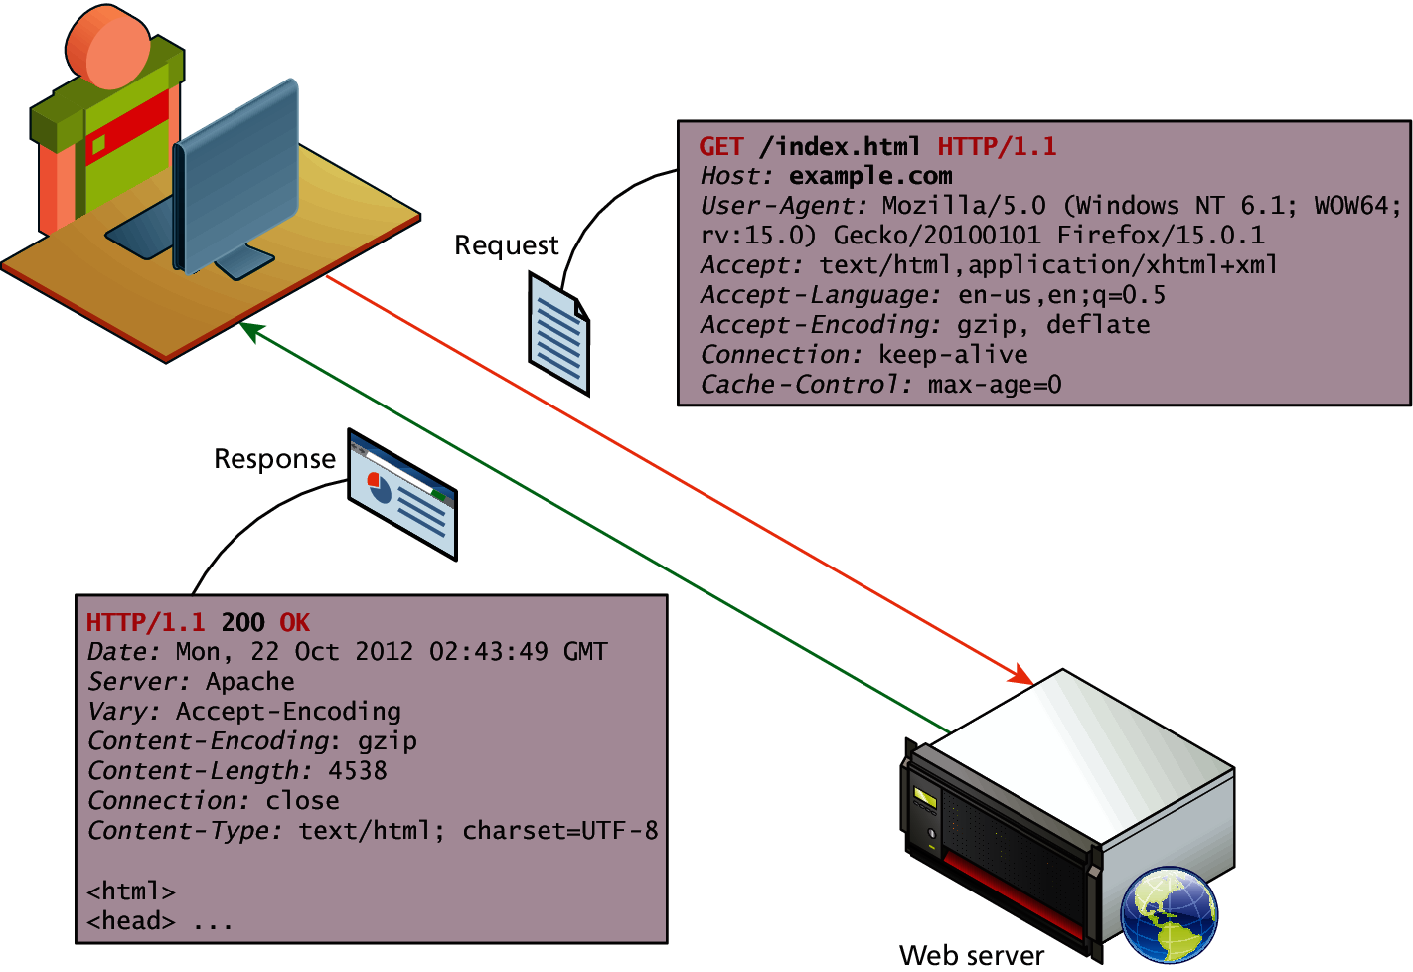
So to review …
The HTTP protocol establishes a TCP connection on port 80 (by default).
The server waits for the request, and then responds with a response code, headers and an optional message (which can include files).

Slide 49
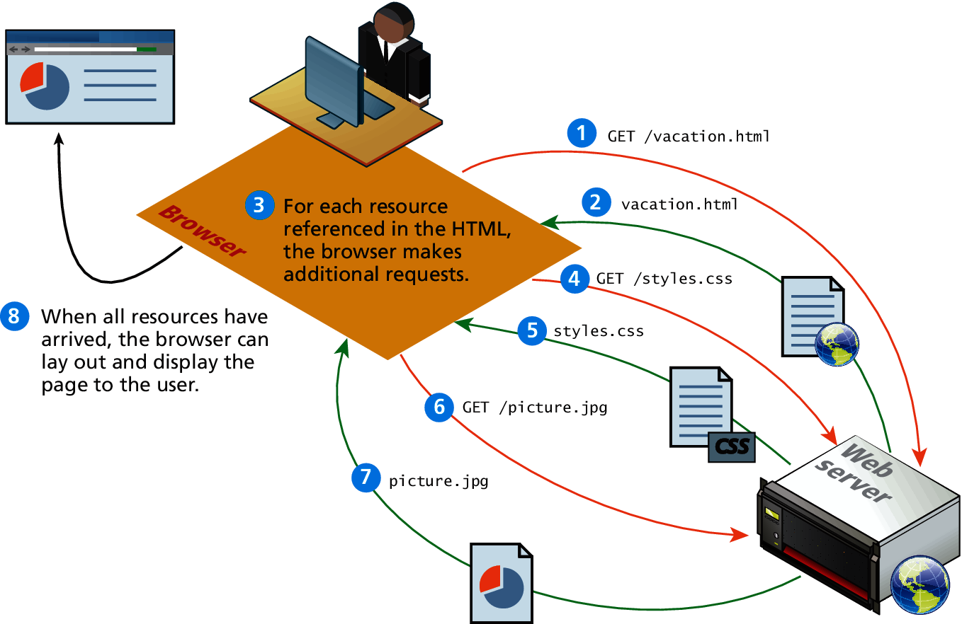
Browser parsing HTML and making subsequent requests

Slide 50
Lets do some HTML/CSS now

Slide 51
Hypertext Markup Language (HTML)
HTML is defined as a markup language.
A markup language is simply a way of annotating a document in such a way to make the annotations distinct from the text being annotated.
This “information about content” in HTML is implemented via tags (aka elements).

Slide 52
What is the W3C?
The W3C is the main standards organization for the World Wide Web.
To promotes compatibility the W3C produces recommendations (also called specifications).
In 1998, the W3C turned its attention to a new specification called XHTML 1.0, which was a version of HTML that used stricter XML (Extensible Markup Language) syntax rules.
The goal of XHTML with its strict rules was to make page rendering more predictable by forcing web authors to create web pages without syntax errors.
Recently W3C proposed HTML5

Slide 53
HTML5
There are three main aims to HTML5:
Specify unambiguously how browsers should deal with invalid markup.
Provide an open, non-proprietary programming framework (via Javascript) for creating rich web applications.
Be backwards compatible with the existing web.
While parts of the HTML5 are still being finalized, all of the major browser manufacturers have at least partially embraced HTML5.
Browsers are increasingly supporting a larger subset of HTML5.

Slide 54
Elements and Attributes
HTML documents are composed of textual content and HTML elements.
An HTML element can contain text, other elements, or be empty.
HTML elements can also contain attributes.
An HTML attribute is a name=value pair that provides more information about the HTML element.

Slide 55
Structure of an HTML page
A header describes the page and the body contains the page’s contents (visible content)
An HTML page is saved into a file ending with extension .html
DOCTYPE tag tells browser to interpret our page’s code as HTML5, the latest & greatest version of the language.
<!DOCTYPE html>
<html>
<head>
<title> Page Title </title>
</head>
<body>
Page Contents
</body>
</html>

Slide 56
Head Tag : <head> …. </head>
The <head> tag describes the page
Head part consists mainly of the following tags
Tag | Description
<title> … </title> | Page title
<link> … </link> | Used to link to a CSS file
<script> … </script> | Used to link to a JavaScript file
<style> … </style> | Used to define style information for a single HTML page (e.g. color, font, etc.)

Slide 57
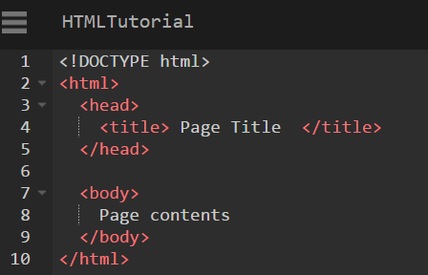
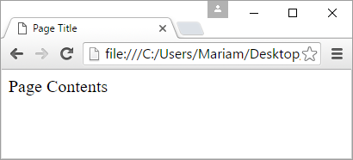
Page title : <title>
The <title> tag describes the title of the webpage
It should be placed within the <head> tag of the page
Displayed in the web browser’s title bar and when bookmarking the page
HTML CODE
OUTPUT

Slide 58
Body Tag: <body> … </body>
The <body> tag contains the visible contents of the webpage
The body part of the page can contains various types of tags:
Tag | Description
<h1> , <h2>, … , <h6> | Heading tags
<p> … </p> | paragraphs
<emph> | Italic text

Slide 59
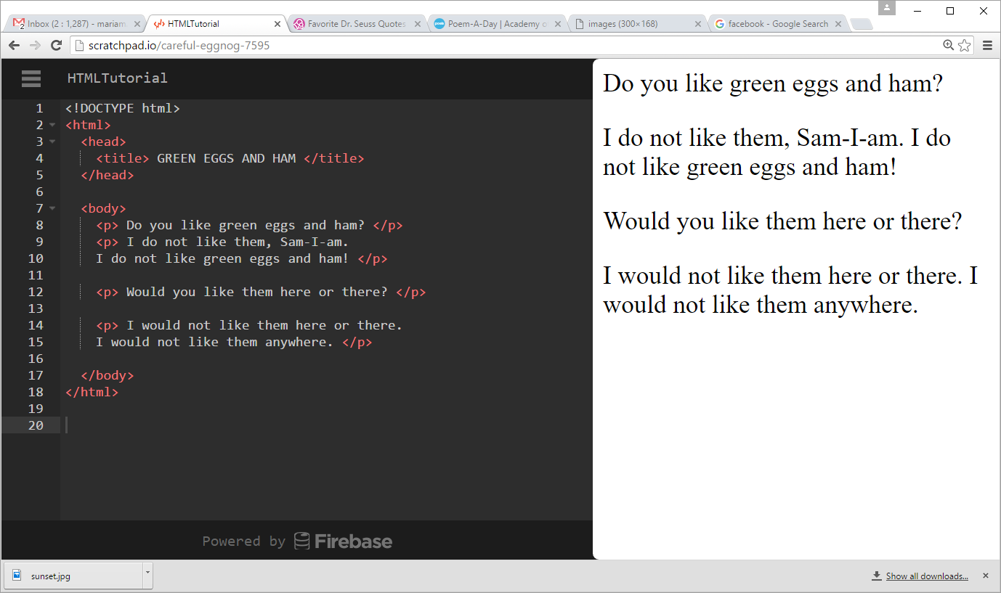
Paragraph: <p>
The <p> tag denotes a paragraph of text (a block )
Placed within the body of the page
More examples : EX1 , EX2
HTML CODE
OUTPUT

Slide 60
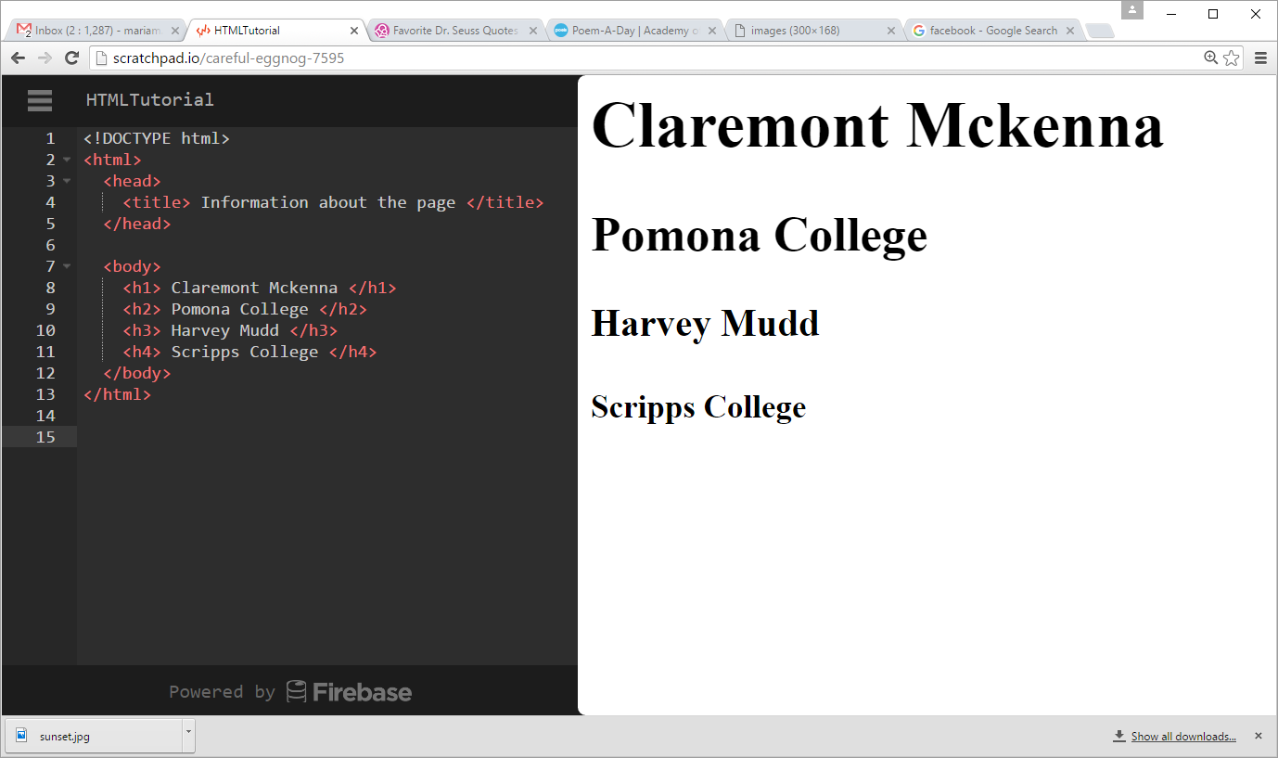
Headings: <h1>, <h2>, …, <h6>
The <h1> , <h2> , … <h6> tags denote headings
Examples: EX1
HTML CODE
OUTPUT

Slide 61
More about HTML tags
Some tags can contain additional information, called attributes
syntax:
<element attribute="value" attribute="value"> content </element>
example:
<a href="page2.htm" > Cool Link! </a>
Tags that don't contain content, can be opened and closed in one tag
syntax: <element attribute="value" attribute="value" />
example: <hr />
example: <img src= "bunny.jpg" alt= "pic from Easter" />

Slide 62
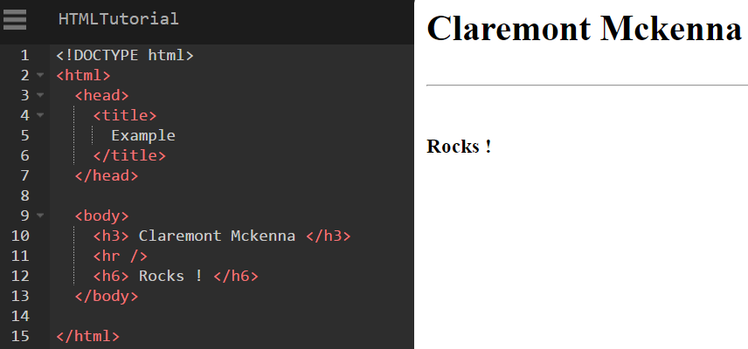
Horizontal Line: <hr>
A horizontal line to visually separate sections of a page
Note, this should be immediately closed with a />
HTML CODE
OUTPUT

Slide 63
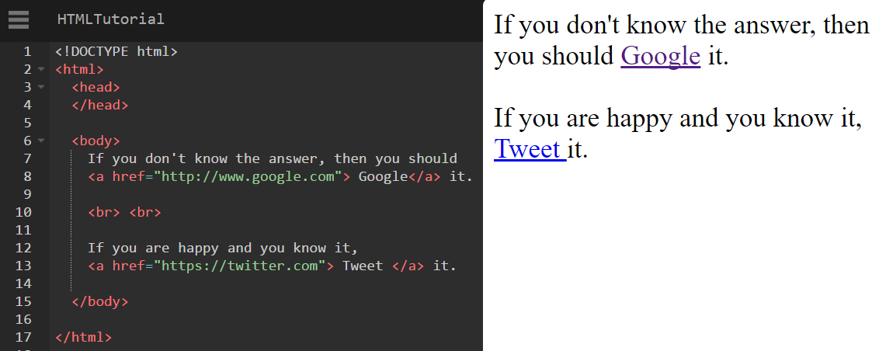
Links: <a>
The href attribute is used to specify a link to a destination URL
can be absolute (to another web site) or
can be relative (to another page on this site)
HTML CODE
OUTPUT

Slide 64
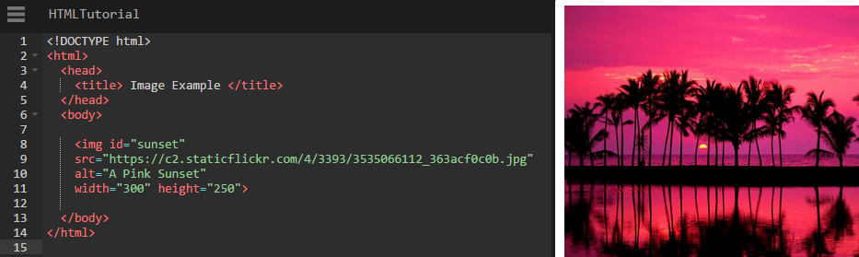
Images: <img>
You can insert images using the <img> tag
The src attribute specifies the image URL
The alt attribute specifies the text displayed if the image is not visible
The width and height attributes specifies the image size
HTML CODE
OUTPUT

Slide 65
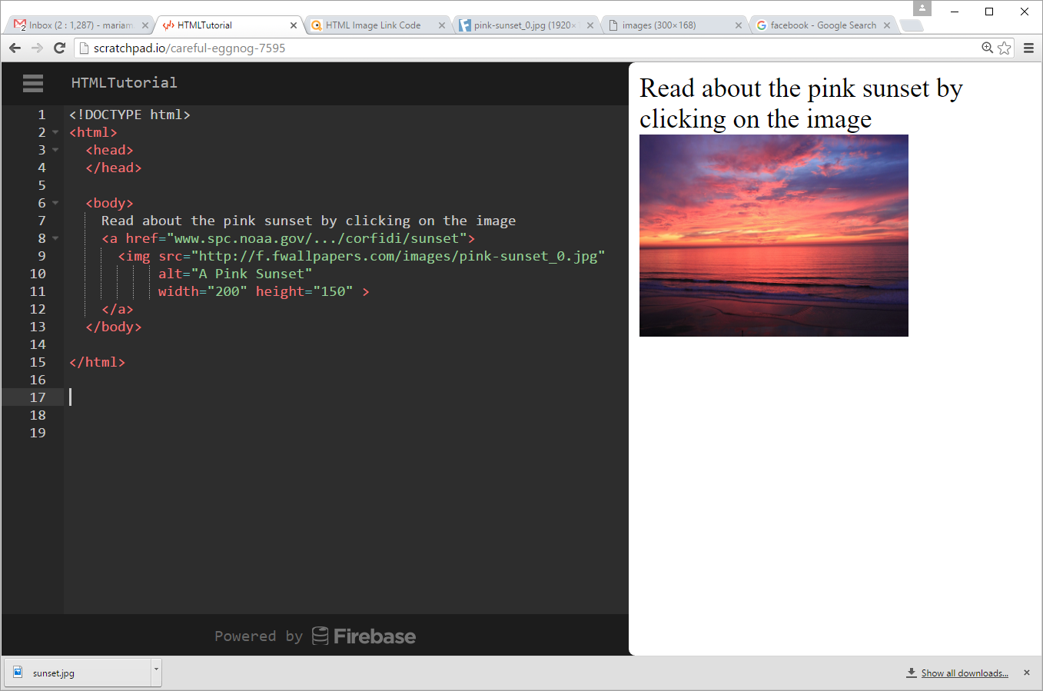
Images as Links: <img> and <a> tag
An image can become a link if embedded within the <a> tag.
HTML CODE
OUTPUT

Slide 66
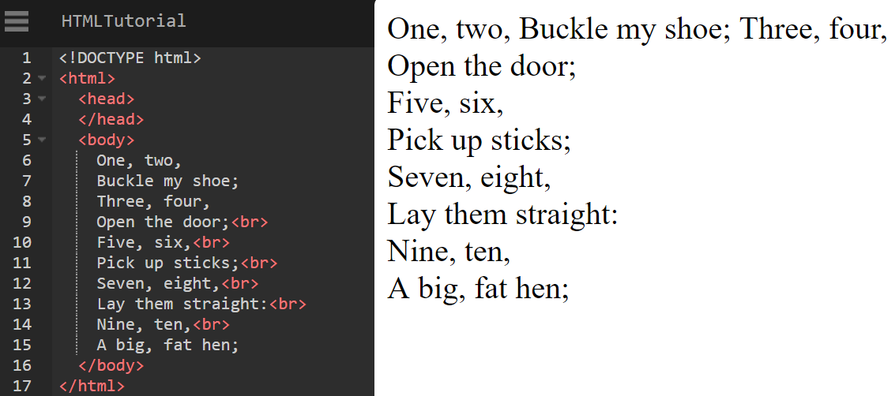
Line break: <br>
The <br> tag forces a line break in the middle of a block element
The <br> tag forces a line break
HTML CODE
OUTPUT

Slide 67
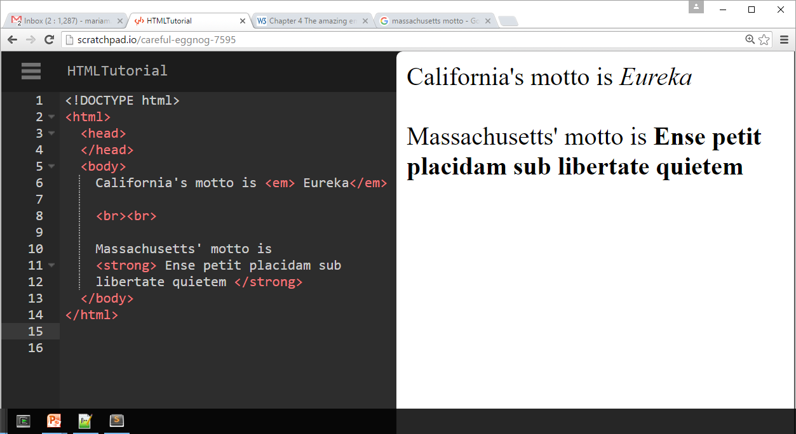
Emphasis: <em>, <strong>
The <em> tag is used to ‘emphasize’ text
The <strong> tag ‘strongly emphasize’ text
HTML CODE
OUTPUT

Slide 68
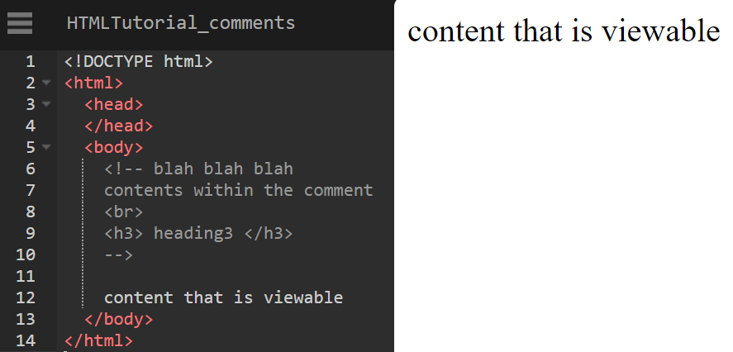
Comments: <!-- ... -->
Comments to document your HTML file
Can be also used to "comment out" text (i.e. disable or make code non-viewable)
Its good practice to thoroughly comment your html
Note, comments cannot be nested and cannot contain a --
HTML CODE
OUTPUT

Slide 69
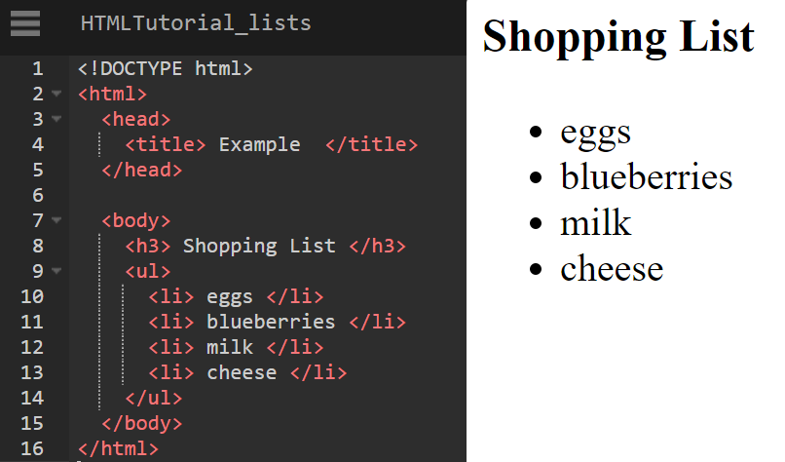
Unordered List : <ul>
The <ul> tag represents a bulleted list of unordered items
Each item within the list is represented with <li> tag
HTML CODE
OUTPUT

Slide 70

Ordered List : <ol>
The <ol> tag represents a bulleted list of ordered items
Each item within the list is represented with <li> tag
HTML CODE
OUTPUT

Slide 71
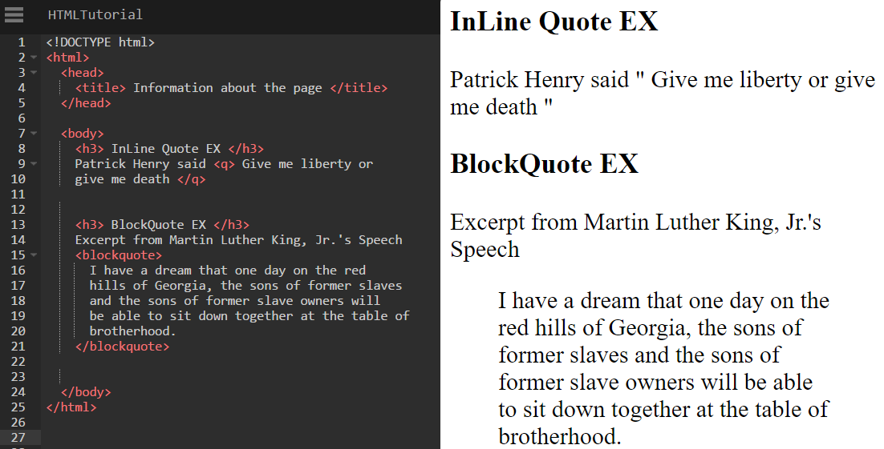
Quotations
Inline Quotations: <q>
Block Quotations: <blockquote>
HTML CODE
OUTPUT

Slide 72
Style
The style of an HTML element (color, font, etc.), can be done with the style attribute.
Syntax : <tagname style= "property:value;" >
Use the style attribute for styling HTML elements
Use background-color for background color
Use color for text colors
Use font-family for text fonts
Use font-size for text sizes
Use text-align for text alignment

Slide 73
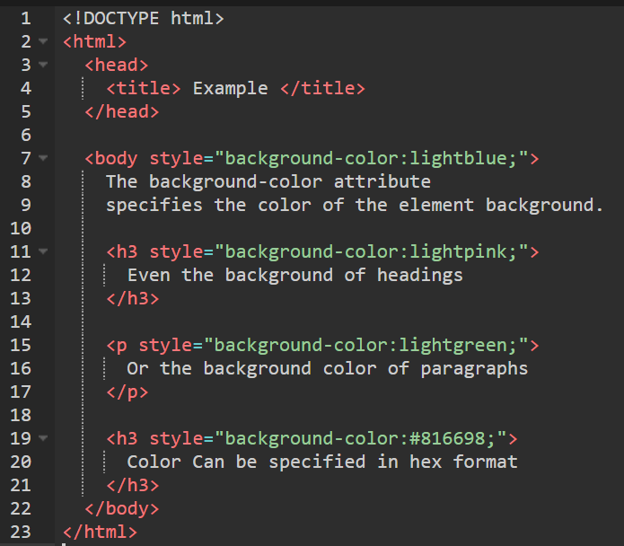
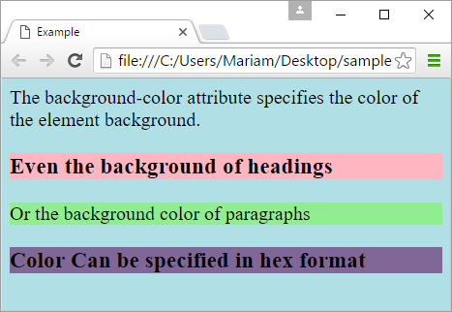
Style (Cont.)
The background-color property defines the background color of the HTML element.
Color codes : http://htmlcolorcodes.com/

Slide 74
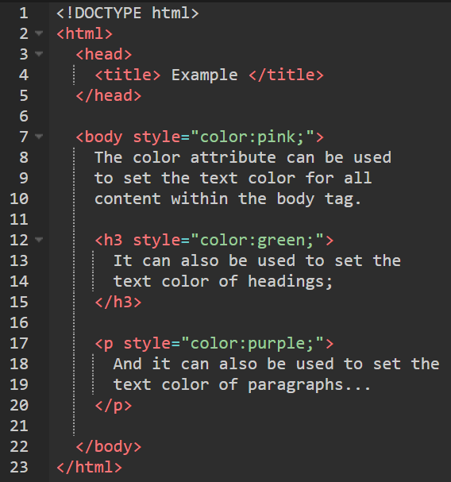
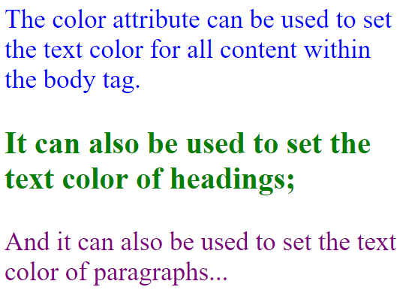
Style (Cont.)
The color property defines the color of text of an HTML element.
Color codes : http://htmlcolorcodes.com/

Slide 75
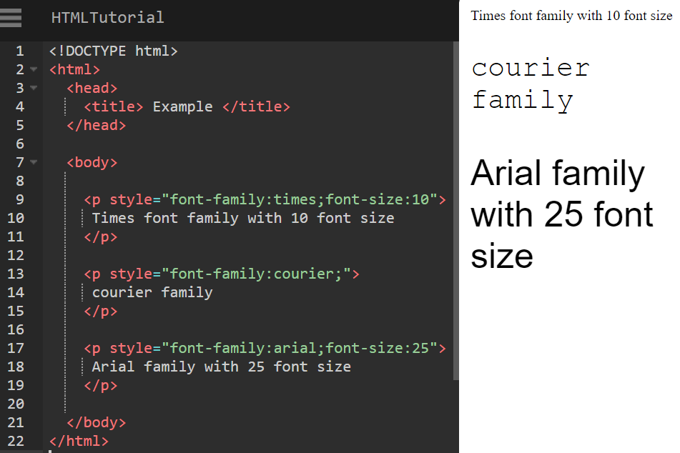
Style (Cont.)
The font-family property defines the font of text, while the font-size attributes defines the size of text.
Reference:

Slide 76
Style (Cont.)
However, what if we want to give all pages of a Web site the same look and feel … it will be very tedious to use inline style tag.
The preferred method is to use Cascading Style Sheet (CSS)
We will cover this next time
CSS is used to separate the style of a site from the content.

Slide 77
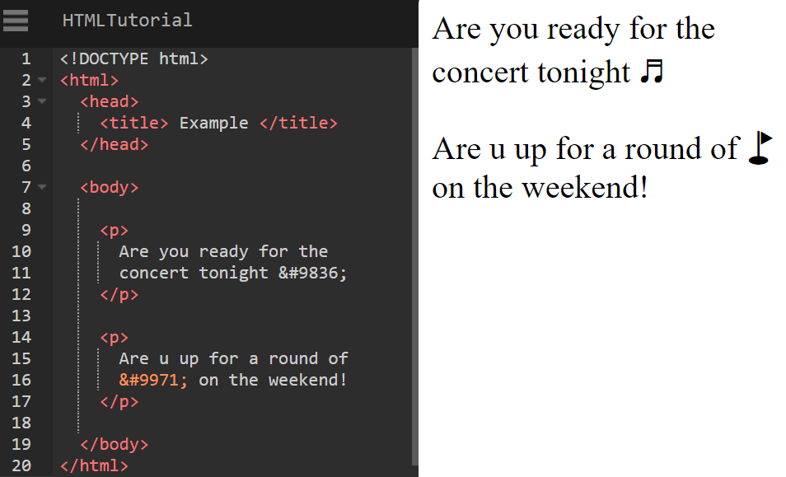
HTML Character Entities
A way of representing any Unicode character within a web page
Complete list of HTML Unicode characters : http://www.w3schools.com/charsets/ref_utf_misc_symbols.asp

Slide 78
W3C HTML Validator
validator.w3.org
checks your HTML code to make sure it follows the official HTML syntax
more picky than the browser, which may render bad HTML correctly

Slide 79
XHTML versus HTML5

Slide 80
Header and Footer
Most web site pages have a recognizable header and footer section.
Typically the header contains
the site logo
title (and perhaps additional subtitles or taglines)
horizontal navigation links, and
perhaps one or two horizontal banners.

Slide 81
Header and Footer
The typical footer contains less important material, such as
smaller text versions of the navigation,
copyright notices,
information about the site’s privacy policy, and
perhaps twitter feeds or links to other social sites.

Slide 82
Header and Footer
Both the HTML5 <header> and <footer> element can be used not only for page headers and footers, they can also be used for header and footer elements within other HTML5 containers, such as <article> or <section>.
<header>
<img src="logo.gif" alt="logo" />
<h1>Fundamentals of Web Development</h1>
...
</header>
<article>
<header>
<h2>HTML5 Semantic Structure Elements </h2>
<p>By <em>Randy Connolly</em></p>
<p><time>September 30, 2012</time></p>
</header>
...
</article>

Slide 83
Heading Groups
The <hgroup> element can be used to group related headings together within one container.
<header>
<hgroup>
<h1>Chapter Two: HTML 1</h1>
<h2>An Introduction</h2>
</hgroup>
</header>
<article>
<hgroup>
<h2>HTML5 Semantic Structure Elements </h2>
<h3>Overview</h3>
</hgroup>
</article>

Slide 84
Navigation
The <nav> element represents a section of a page that contains links to other pages or to other parts within the same page.
Like the other new HTML5 semantic elements, the browser does not apply any special presentation to the <nav> element.
The <nav> element was intended to be used for major navigation blocks, presumably the global and secondary navigation systems.
<header>
<img src="logo.gif" alt="logo" />
<h1>Fundamentals of Web Development</h1>
<nav role="navigation">
<ul>
<li><a href="index.html">Home</a></li>
<li><a href="about.html">About Us</a></li>
<li><a href="browse.html">Browse</a></li>
</ul>
</nav>
</header>

Slide 85
Articles and Sections
The <article> element represents a section of content that forms an independent part of a document or site; for example, a magazine or newspaper article, or a blog entry.
The <section> element represents a section of a document, typically with a title or heading.

Slide 86
Sections versus Divs
The WHATWG specification warns readers that the <section> element is not a generic container element. HTML already has the <div> element for such uses.
When an element is needed only for styling purposes or as a convenience for scripting, it makes sense to use the <div> element instead.
Another way to help you decide whether or not to use the <section> element is to ask yourself if it is appropriate for the element's contents to be listed explicitly in the document's outline.
If so, then use a <section>; otherwise use a <div>.

Slide 87
Figure and Figure Captions
The W3C Recommendation indicates that the <figure> element can be used not just for images but for any type of essential content that could be moved to a different location in the page or document and the rest of the document would still make sense.

Slide 88
Figure and Figure Captions
The <figure> element should not be used to wrap every image.
For instance, it makes no sense to wrap the site logo or non-essential images such as banner ads and graphical embellishments within <figure> elements.
Instead, only use the <figure> element for circumstances where the image (or other content) has a caption and where the figure is essential to the content but its position on the page is relatively unimportant.

Slide 89
Figure and Figure Captions

Slide 90
Cascading Style Sheets
What is CSS?

Slide 91
What is CSS?
CSS is a W3C standard for describing the presentation (or appearance) of HTML elements.
CSS can be added directly to any HTML element (via the style attribute), within the <head> element, or, most commonly, in a separate text file that contains only CSS.
With CSS, we can assign
font properties,
colors,
sizes,
borders,
background images,
even the position of elements.

Slide 92
Benefits of CSS
The degree of formatting control in CSS is significantly better than that provided in HTML.
Web sites become significantly more maintainable because all formatting can be centralized into one, or a small handful, of CSS files.
CSS-driven sites are more accessible, because …
A site built using a centralized set of CSS files for all presentation will also be quicker to download because each individual HTML file will contain less markup.

Slide 93
CSS Syntax
A CSS document consists of one or more style rules.
A rule consists of a selector that identifies the HTML element or elements that will be affected, followed by a series of property and value pairs (each pair is also called a declaration).
A declaration block can be together on a single line, or spread across multiple lines.
The selector identifies which element or elements in the HTML document will be affected by the declarations in the rule.

Slide 94
Declaration Blocks
The series of declarations is also called the declaration block.
A declaration block can be together on a single line, or spread across multiple lines.
The browser ignores white space
Each declaration is terminated with a semicolon.

Slide 95
Selectors
Every CSS rule begins with a selector.
The selector identifies which element or elements in the HTML document will be affected by the declarations in the rule.
Another way of thinking of selectors is that they are a pattern which is used by the browser to select the HTML elements that will receive the style.

Slide 96
Properties
Each individual CSS declaration must contain a property.
These property names are predefined by the CSS standard.
The CSS2.1 Recommendation defines over a hundred different property names.

Slide 97
Values
Each CSS declaration also contains a value for a property.
The unit of any given value is dependent upon the property.
Some property values are from a predefined list of keywords.
Others are values such as length measurements, percentages, numbers without units, color values, and URLs.

Slide 98
Properties
Property Type | Property
Fonts | font font-family font-size font-style font-weight @font-face
Text | letter-spacing line-height text-align text-decoration text-indent
Color and background | background background-color background-image background-position background-repeat color
Borders | border border-color border-width border-style border-top border-top-color border-top-width etc
Property Type | Property
Spacing | padding padding-bottom, padding-left, padding-right, padding-top margin margin-bottom, margin-left, margin-right, margin-top
Sizing | height max-height max-width min-height min-width width
Layout | bottom, left, right, top clear display float overflow position visibility z-index
Lists | list-style list-style-image list-style-type

Slide 99
Style Locations
CSS style rules can be located in three different locations.
Inline
Embedded
External
And you can combine all 3!

Slide 100
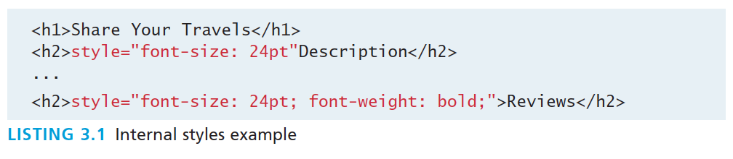
Inline Styles
An inline style only affects the element it is defined within and will override any other style definitions for the properties used in the inline style.
Using inline styles is generally discouraged since they increase bandwidth and decrease maintainability.
Inline styles can however be handy for quickly testing out a style change.

Slide 101
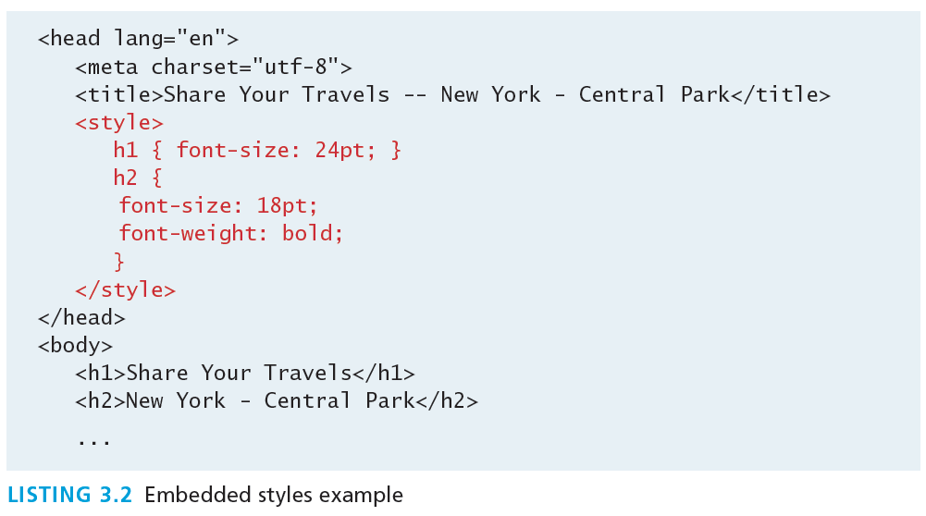
Embedded Style Sheet
While better than inline styles, using embedded styles is also by and large discouraged.
Since each HTML document has its own <style> element, it is more difficult to consistently style multiple documents when using embedded styles.

Slide 102
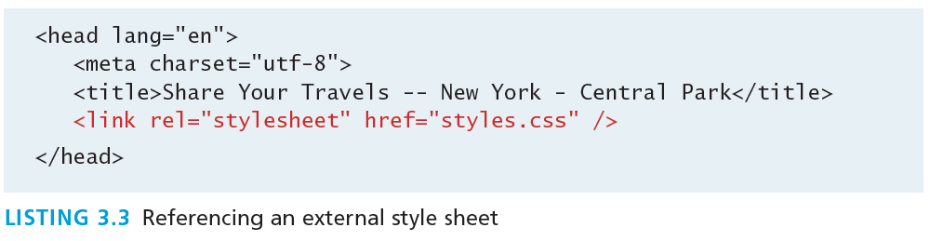
External Style Sheet
Style rules placed within a external text file with the .css extension
This is by far the most common place to locate style rules because it provides the best maintainability.
When you make a change to an external style sheet, all HTML documents that reference that style sheet will automatically use the updated version.
The browser is able to cache the external style sheet which can improve the performance of the site

Slide 103
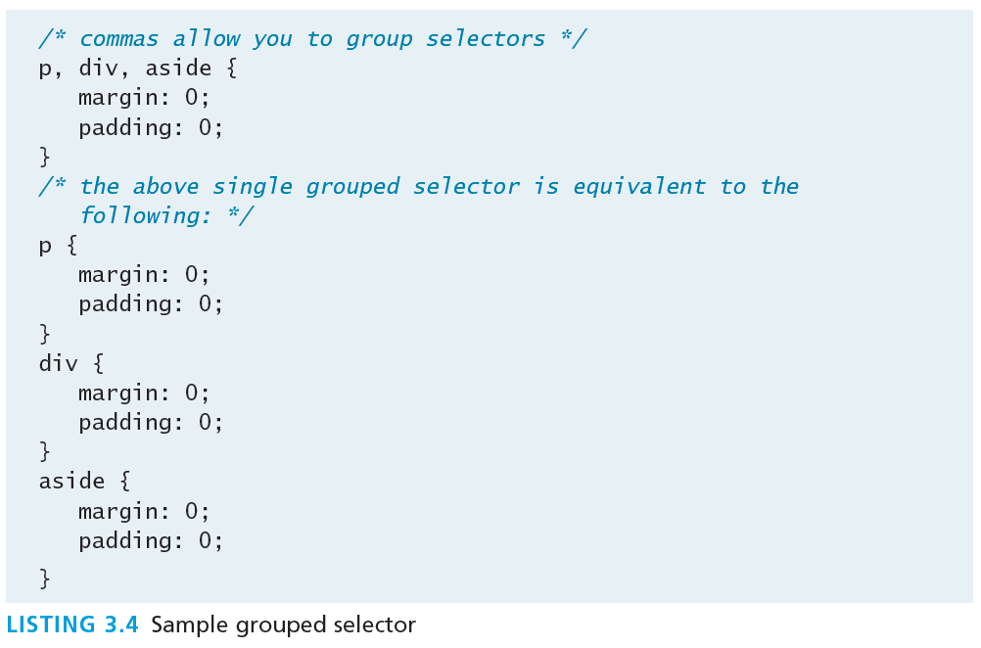
Selectors
When defining CSS rules, you need to specify a selector that denotes which element is selected.
CSS selectors allow you to select
individual or multiple HTML elements,
elements that belong together in some way, or
elements that are positioned in specific ways in the document hierarchy.
There are a number of different selector types.

Slide 104
Class Selectors
<head>
<title>Share Your Travels </title>
<style>
.first {
font-style: italic;
color: brown;
}
</style>
</head>
<body>
<h1 class="first">Reviews</h1>
<div>
<p class="first">By Ricardo on <time>September 15, 2012</time></p>
<p>Easy on the HDR buddy.</p>
</div>
<hr/>
<div>
<p class="first">By Susan on <time>October 1, 2012</time></p>
<p>I love Central Park.</p>
</div>
<hr/>
</body>
A class selector allows you to simultaneously target different HTML elements regardless of their position in the document tree.
If a series of HTML element have been labeled with the same class attribute value, then you can target them for styling by using a class selector, which takes the form: period (.) followed by the class name.

Slide 105
Id Selectors
<head lang="en">
<meta charset="utf-8">
<title>Share Your Travels -- New York - Central Park</title>
<style>
#latestComment {
font-style: italic;
color: brown;
}
</style>
</head>
<body>
<h1>Reviews</h1>
<div id="latestComment">
<p>By Ricardo on <time>September 15, 2012</time></p>
<p>Easy on the HDR buddy.</p>
</div>
<hr/>
<div>
<p>By Susan on <time>October 1, 2012</time></p>
<p>I love Central Park.</p>
</div>
<hr/>
</body>
An id selector allows you to target a specific element by its id attribute regardless of its type or position.
If an HTML element has been labeled with an id attribute, then you can target it for styling by using an id selector, which takes the form: pound/hash (#) followed by the id name.
Note: You should only be using an id once per page

Slide 106
Id versus Class Selectors
Id selectors should only be used when referencing a single HTML element since an id attribute can only be assigned to a single HTML element.
Class selectors should be used when (potentially) referencing several related elements.
Inaddition to id & class selectors, there are
Attribute
Contextual

Slide 107
Attribute Selectors
An attribute selector provides a way to select HTML elements by either the presence of an element attribute or by the value of an attribute.
<head lang="en">
<meta charset="utf-8">
<title>Share Your Travels</title>
<style>
[title] {
cursor: help;
padding-bottom: 3px;
border-bottom: 2px dotted blue;
text-decoration: none;
}
</style>
</head>
<body>
<div>
<img src="images/flags/CA.png" title="Canada Flag" />
<h2><a href="countries.php?id=CA" title="see posts from Canada">
Canada</a>
</h2>
<p>Canada is a North American country consisting of … </p>
<div>
<img src="images/square/6114907897.jpg" title="At top of Sulpher Mountain">
<img src="images/square/6592317633.jpg" title="Grace Presbyterian Church">
<img src="images/square/6592914823.jpg" title="Calgary Downtown">
</div>
</div>
</body>

Slide 108
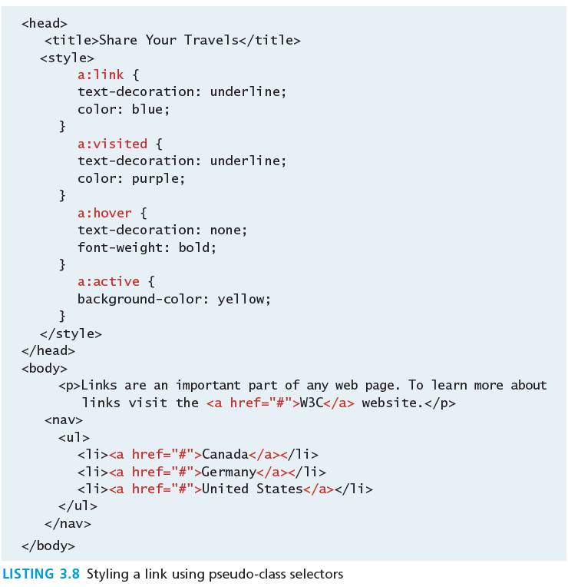
More Selectors
A pseudo-element selector is a way to select something that does not exist explicitly as an element in the HTML document tree but which is still a recognizable selectable object.
A contextual selector allows you to select elements based on their ancestors, descendants, or siblings.

Slide 109
If there is conflict
The CSS can define multiple rules for the same HTML element, and the rules may conflict.
The “Cascade” in CSS refers to how conflicting rules are handled.
CSS uses the following cascade principles to help it deal with conflicts:
inheritance
specificity
location

Slide 110
Inheritance (Cascade Principle #1)
Many (but not all) CSS properties affect not only themselves but their descendants as well.
Font, color, list, and text properties are inheritable.
Layout, sizing, border, background and spacing properties are not inheritable.

Slide 111
Inheritance (Cascade Principle #1)
It is possible to tell elements to inherit properties that are normally not inheritable.

Slide 112
Specificity (Cascade Principle #2)
Specificity is how the browser determines which style rule takes precedence when more than one style rule could be applied to the same element.
The more specific the selector, the more it takes precedence (i.e., overrides the previous definition).
How it works?
The browser assigns a weight to each style rule.
When several rules apply, the one with the greatest weight takes precedence.

Slide 113
Specificity
These color and font-weight properties are inheritable and thus potentially applicable to all the child elements contained within the body.
However, because the <div> and <p> elements also have the same properties set, they override the value defined for the <body> element because their selectors (div and p) are more specific.
Class selectors are more specific than element selectors, and thus take precedence and override element selectors.
Id selectors are more specific than class selectors, and thus take precedence and override class selectors.

Slide 114
Location (Cascade Principle #3)
When inheritance and specificity cannot determine style precedence, the principle of location will be used.
The principle of location is that when rules have the same specificity, then the latest are given more weight.
Notes:
There is one exception to the principle of location.
If a property is marked with !important in an author-created style rule, then it will override any other author-created style regardless of its location.
The only exception is a style marked with !important in an user style sheet; such a rule will override all others.

Slide 115
The Box Model
In CSS, all HTML elements exist within an element box.
Four properties are applied:
Background
Border
Margins
Padding

Slide 116
Background
Property | Description
background | A combined short-hand property that allows you to set the background values in one property.
background-attachment | Specifies whether the background image scrolls with the document (default) or remains fixed. Possible values are: fixed, scroll.
background-color | Sets the background color of the element.
background-image | Specifies the background image for the element.
background-position | Specifies where on the element the background image will be placed. Possible values include: bottom, center, left, and right.
background-repeat | Determines whether the background image will be repeated. Possible values are: repeat, repeat-x, repeat-y, and no-repeat.
background-size | New to CSS3, this property lets you modify the size of the background image.
The background color or image of an element fills an element out to its border (if it has one that is).

Slide 117
Borders
Property | Description
border | A short-hand property that allows you to set the style, width, and color of a border in one property. The order is important and must be: border-style border-width border-color
border-style | Specifies the line type of the border. Possible values are: solid, dotted, dashed, double, groove, ridge, inset, and outset.
border-width | The width of the border in a unit (but not percents). A variety of keywords (thin, medium, etc) are also supported.
border-color | The color of the border in a color unit.
border-radius | The radius of a rounded corner.
border-image | The URL of an image to use as a border.
Borders provide a way to visually separate elements.
You can put borders around all four sides of an element, or just one, two, or three of the sides.
border-top-color: red; /* sets just the top side */
border-right-color: green; /* sets just the right side */
border-bottom-color: yellow; /* sets just the bottom side */
border-left-color: blue; /* sets just the left side */
border-color: red; /* sets all four sides to red */
border-color: red green orange blue; /* sets all four sides differently */
When using this multiple values shortcut, they are applied in clockwise order starting at the top.
Thus the order is: top right bottom left.

Slide 118
Margins and Padding
When the vertical margins of two elements touch,
the largest margin value of the elements will be displayed
the smaller margin value will be collapsed to zero.
Horizontal margins, on the other hand, never collapse.
To complicate matters even further, there are a large number of special cases in which adjoining vertical margins do not collapse

Slide 119
Width and Height
The width and height properties specify the size of the element’s content area.
Only block-level elements and non-text inline elements such as images have a width and height that you can specify.
By default the width of and height of elements is the actual size of the content.
For text,
this is determined by the font size and font face;
For images,
the width and height of the actual image in pixels determines the element box’s dimensions.

Slide 120
Width and Height

Slide 121
Sizing Elements
Previous examples used pixels for its measurement, but many prefer to use percentages or em units for widths and heights.
When you use percentages, the size is relative to the size of the parent element.
When you use ems, the size of the box is relative to the size of the text within it.
The rationale behind using these relative measures is to make one’s design scalable to the size of the browser or device that is viewing it.

Slide 122
Specifying the Font-Family & Font-Size

Slide 123
ems and percents
If we wish to create web layouts that work well on different devices, we should learn to use relative units such as em units or percentages for our font sizes (and indeed for other sizes in CSS as well).

Slide 124
The rem unit
CSS3 now supports a new relative measure, the rem (for root em unit).
This unit is always relative to the size of the root element (i.e., the <html> element).

